Slide 1
An introduction to research

Slide 2
Jobs
I can initiate an interaction in my preferred method of communication.
I can discuss what key words mean.
I can listen carefully and show interest in what is being presented.
I can take turns to discuss the text we have read as a small group.

Slide 3
What is research?
Research is an investigation or a ‘hunt’ to discover more knowledge about a particular problem, topic or issue.

Slide 4
Research changes what people think and do!
Genetic fingerprinting
Every individual is unique – and so are our fingerprints.
Alec Jeffreys’s research at the University of Leicester in 1985 lead to the discovery that each person’s fingerprint is totally unique, making it a reliable and full-proof identification technique. Very handy for catching a burglar!
The universe is expanding
The universe is getting bigger. This happened after an explosion, the Big Bang. We know this thanks to research.
The world’s first computer
Phones and computers are only available to us now thanks to Freddie Williams and Tom Kilburn’s research at the University of Manchester in 1948.

Slide 5
Research has shaped our world and lead to some incredible and sometimes terrifying discoveries!

Slide 6
The topic:

Slide 7
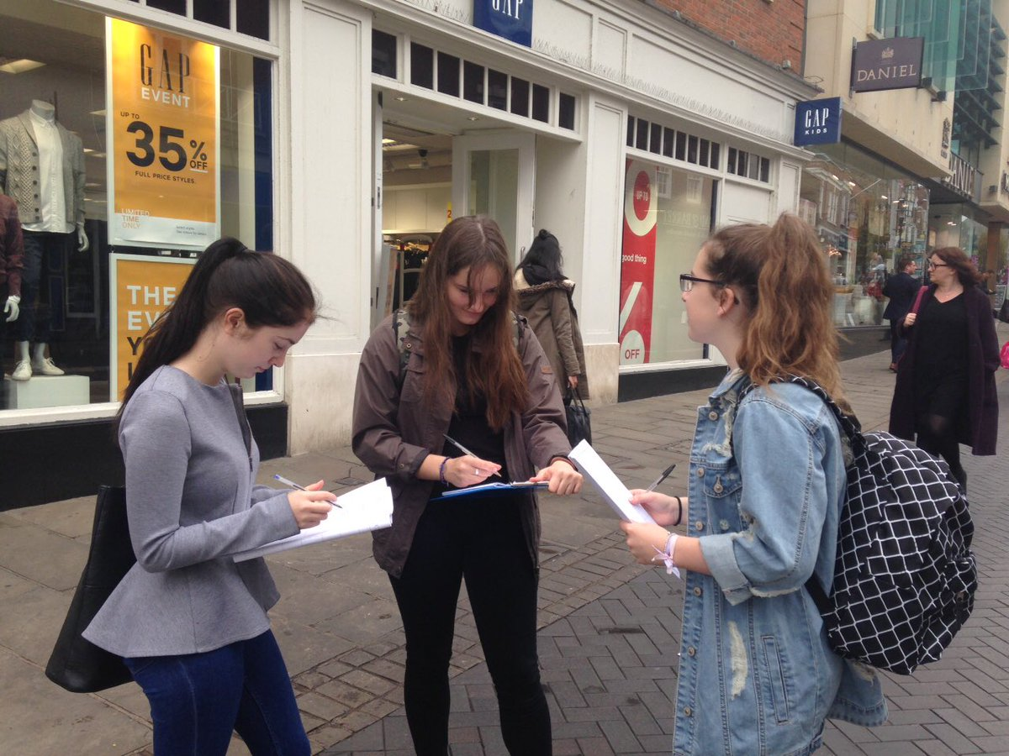
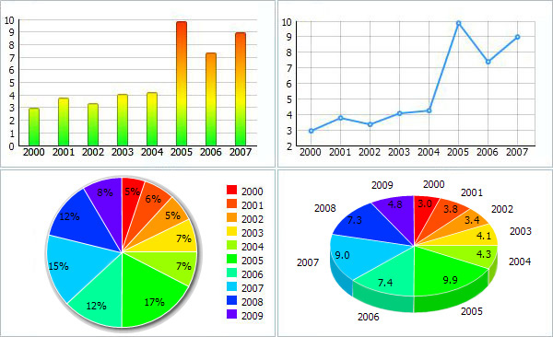
1. Find a topic
2. Gather information
5. Present our research
3. Evaluate what we have
4. Organise our information

Slide 8
Predictions: What might our data show?

Slide 9
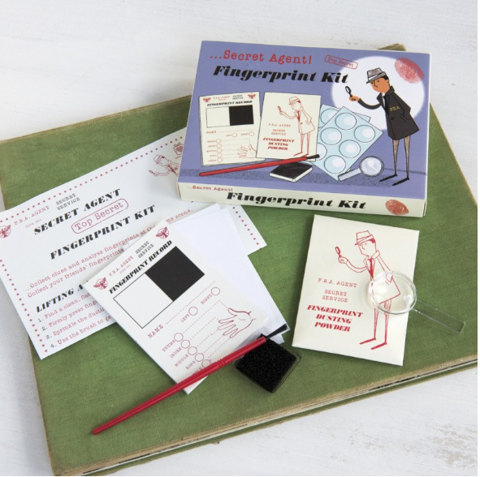
Fingerprint task
In groups take each others fingerprints.
Compare your fingerprints.
What have you learnt?
How might this be useful?

